Slide 1
Nuclear Medicine
Radiopharmaceutical chemistry

Slide 2
Positron Emission Tomography
What is PET ?
By which principle it work ?
How can be performed ?
Benefits and risks ?
Common isotopes used?
Main differences between PET and CT scan ?

Slide 3
PET scan is a functional imaging technique that is used to observe metabolic processes in the body.
Positron emission tomography (PET):
uses small amounts of radioactive materials called radiotracers(the biological active molecule chosen Fludeoxyglucose(FDG) an analogue of glucose)
a special camera and a computer to help evaluate your organ and tissue functions.
By identifying body changes at the cellular level ,recently use of PET to detect the cancer tumours, may also used in cardiology and neurology.

Slide 4
PET principle
PET use x-ray in order to present a 3D picture
short line radioactive tracer isotope injected into the living subject usually in blood circulation ,the tracer is chemically incorporated into a biological active molecule
There is a waiting period while the active molecule become concentrated in tissues of inert
Radioisotope undergo a PE decay it will emit a positron

Slide 5
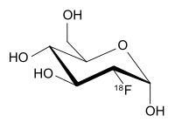
Fludeoxyglucose(FDG) an analogue of glucose

Slide 6
PET principle
Travelling few(milli meter)the positron encounter an electron
The encounter annihilates them both produce a pair of (gamma) photon moving in opposite directions
These are detected when they reach scintillators in the scanning device create a burst of light
The technicians can the create an image of the parts of brain for example which are overactive

Slide 7
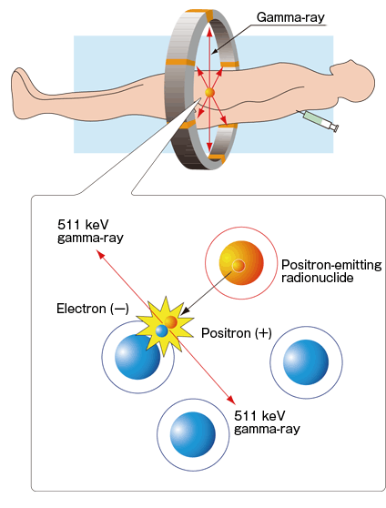
Principle of work

Slide 8
How can we performed it ?
If you’re pregnant or believe you could be pregnant, tell your doctor. The test may be unsafe for your baby. You should also tell your doctor about any medical conditions you have. If you have diabetes, you’ll get special instructions for test preparation because fasting beforehand could affect your blood sugar levels.

Slide 9
How can we performed it ?
Before the scan, you’ll get tracers through a vein in your arm, through a solution you drink, or in a gas you inhale. Your body needs time to absorb the tracers, so you’ll wait about an hour before the scan begins.
Next, you’ll undergo the scan. This involves lying on a narrow table attached to a PET machine, which looks like a giant letter “O.” The table glides slowly into the machine so that the scan can be conducted.

Slide 10
How can we performed it ?
You’ll need to lie still during the scan
You may be asked to hold your breath for short periods.
You’ll hear buzzing and clicking noises during the test.
When all the necessary images have been recorded, you will slide out of the machine. The test is then complete.

Slide 11
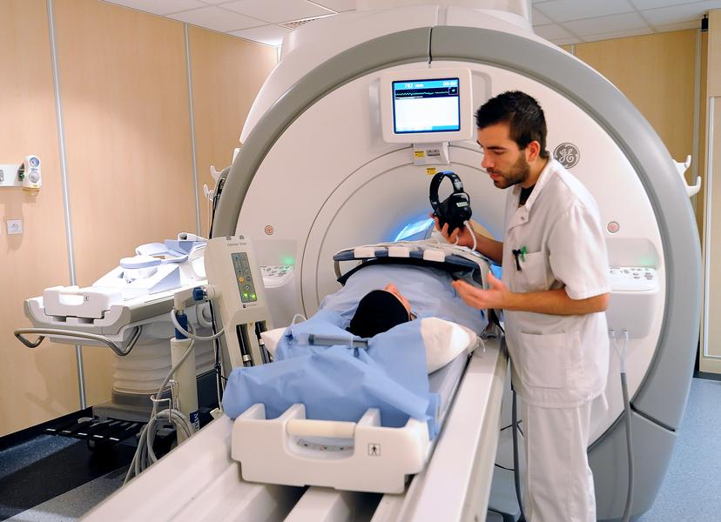
Performance of PET scan
A picture clarify the process of diagnosis of pathological conditions or any other abnormalities and complications ,

Slide 12
Benefits
medicine examinations provide unique information—including details on both function and anatomic structure of the body .
nuclear medicine scans yield the most useful information needed to make a diagnosis or to determine appropriate treatment .
Nuclear medicine is less expensive and may yield more information than surgery by identifying changes in the body at the cellular level .

Slide 13
Risks
A radioactive drug (tracer) will be put into body. The amount of radiation was exposed, and the risk of negative effects
Cause a major allergic reaction.
Expose unborn baby to radiation if pregnant
Expose your child to radiation if breast-feeding

Slide 14
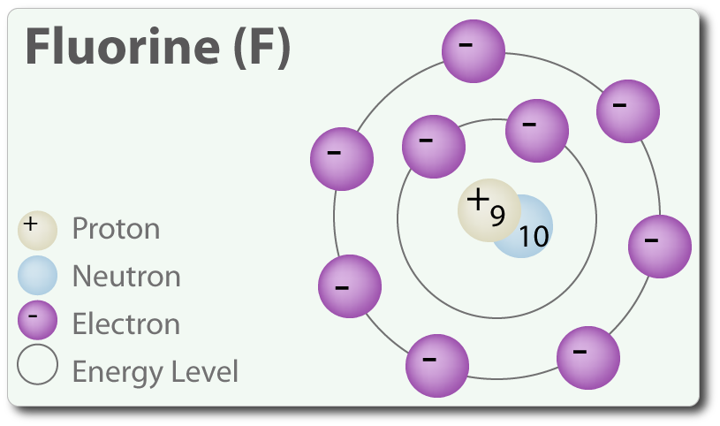
Fluorine isotope (most common use isotope )
Isotope:- each of two or more forms of the same element that contain equal numbers of protons but different numbers of neutrons in their nuclei, and hence differ in relative atomic mass but not in chemical properties

Slide 15
Common isotops used in PET scan
Isotope | Half-life | Maximum energy (Mev) | Range in water (mm)
¹⁸F | 109.7 min | 0.635 | 2.39
¹¹C | 20.4 min | 0.96 | 4.11
¹³N | 9.96 min | 1.19 | 5.39
¹⁵O | 2.07 min | 1.72 | 8.2

Slide 16
Difference between PET and CT scan
PET
CT scan
Higher cost than CT
Take 2-4 hours to complete scan
Radiation exposure from moderate to high
Use radioactive tracer
Can image biological process of the body
Cost less than PET and MRI
Completed within 5 min ,so its less sensitive to patient
The effective radiation dose from CT ranges from 2 to 10 (mSv)
Use x-ray for imaging
CT can outline bone inside the body very accurately

Slide 17
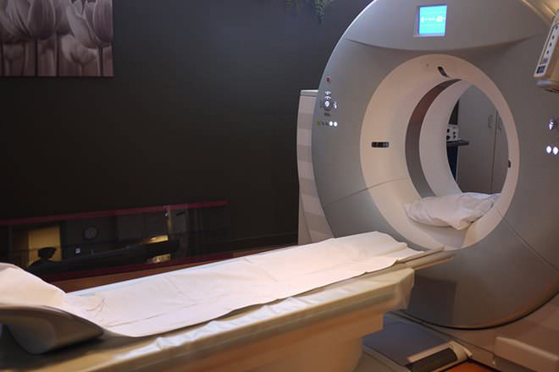
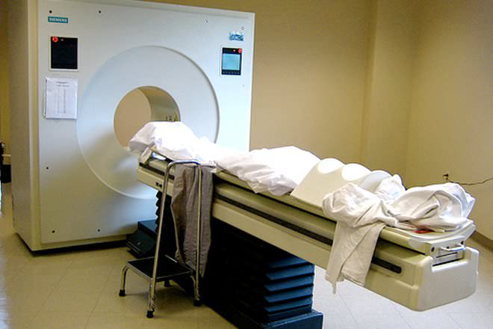
Difference
CT scan
PET scan

Slide 18
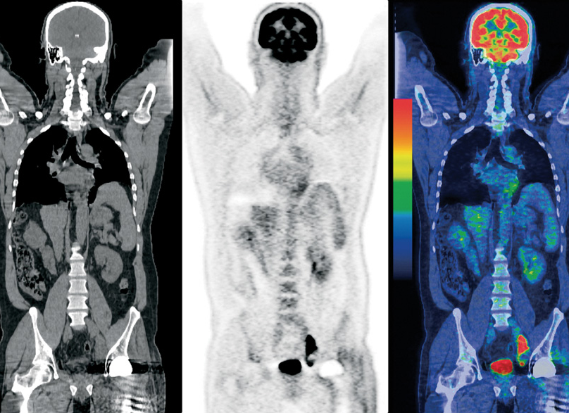
PET\CT scan image
Image taken by PET to the left side ,the middle one taken by CT scan ,while the last one is both PET\CT scan combined image

Slide 19
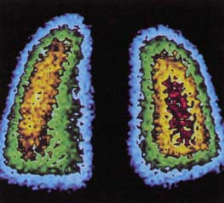
Images of human lungs obtained from a γ-ray scan

